Slide 1
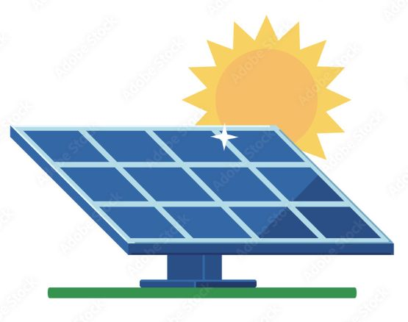

Minor Project presentation
Solar tracking system using Arduino
Asha
Date of Presentation: 16-02-2024
Under the guidance of:
CS Department HOD
2
Department of Computer Science,
Shridhar University Pilani
Notes:
1

Slide 2
Content
Introduction
Component required
Circuit diagram
Arduino code
Conclusions
Future Scope
References
2
Solar tracking system using Arduino
Notes:
2

Slide 3
Introduction
Solar tracker is a system that positions an object at an angle relative to the sun.
The most common applications for solar trackers are positioning photovoltaic(PV)panels(Solar Panels)so that they remain perpendicular to the sun’s rays and positioning space telescopes so that they can determine the Sun’s direction.
3
Solar tracking system using Arduino
Notes:
3

Slide 4
Component required
Arduino UNO board
Solar panel(5V 3W)
SG90 mini servo motor(5V)
LDR sensor 2
10k resistor 2
USB DC 3.7V to DC 5V
Cardboard
Male Header
Jumper wire
4
Solar tracking system using Arduino
Notes:
4

Slide 5
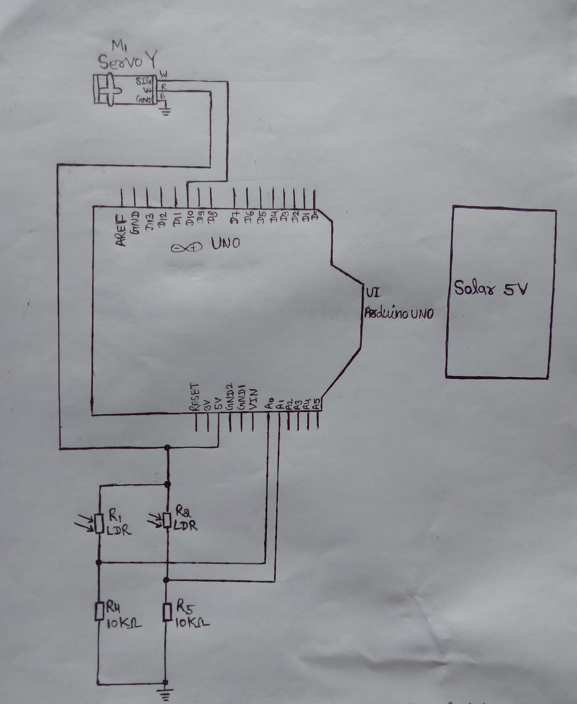
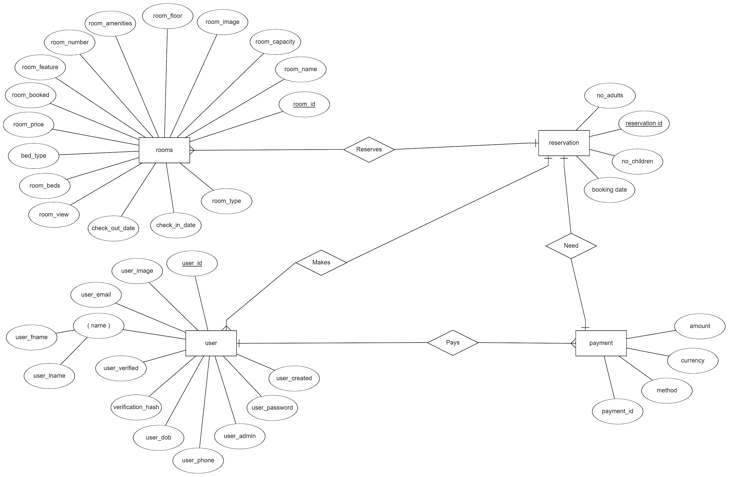
Circuit Diagram
5
Solar tracking system using Arduino
Notes:
5

Slide 6
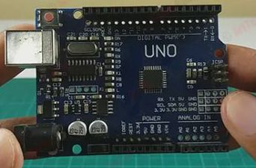
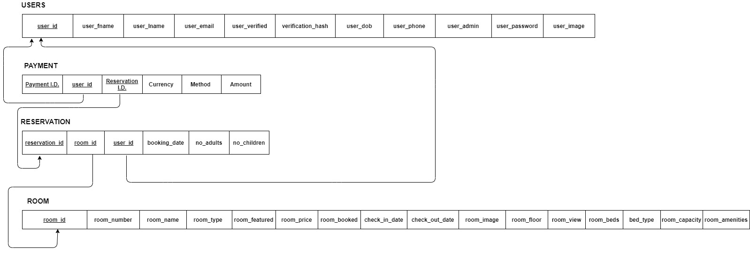
Components Arduino UNO
6
Solar tracking system using Arduino
Notes:
6

Slide 7
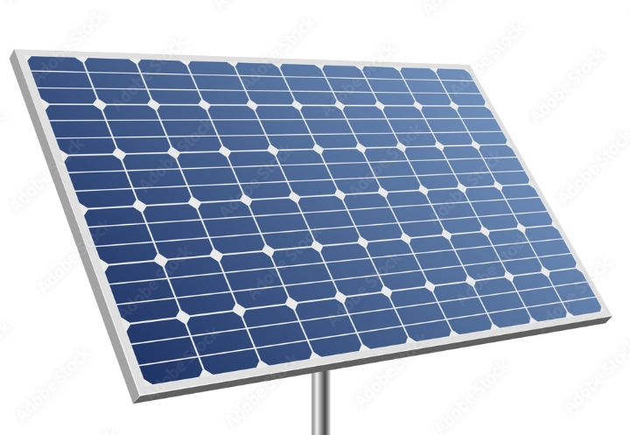
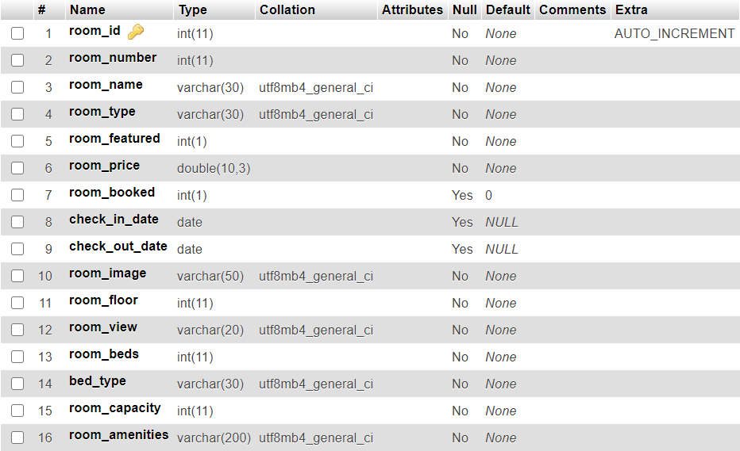
Solar panel
Room Table
7
Solar tracking system using Arduino
Notes:
7

Slide 8
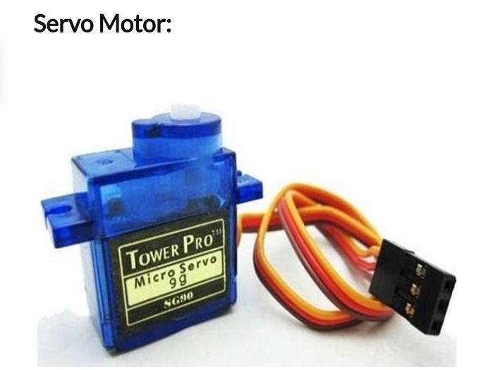
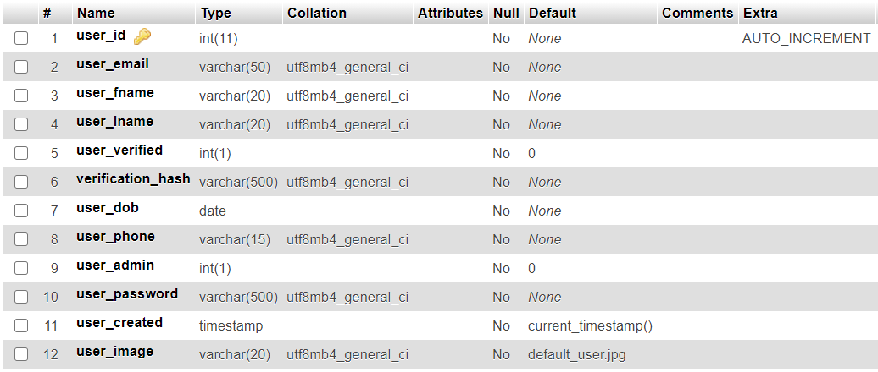
User Table
8
Solar tracking system using Arduino
Notes:
8

Slide 9
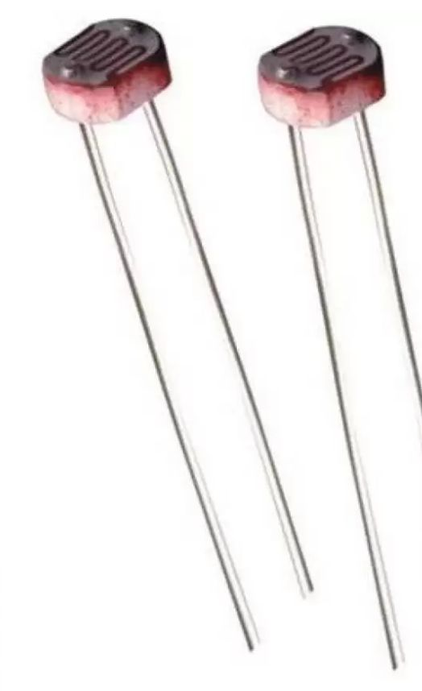
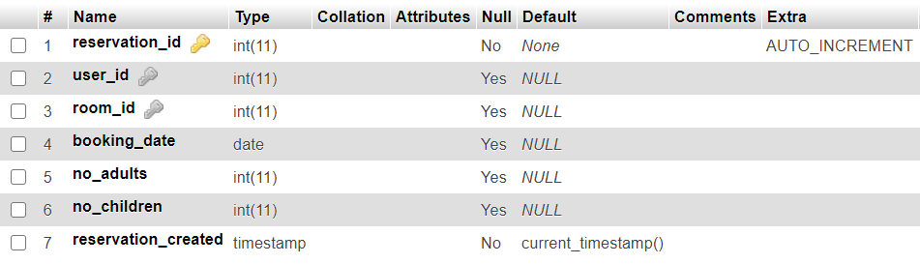
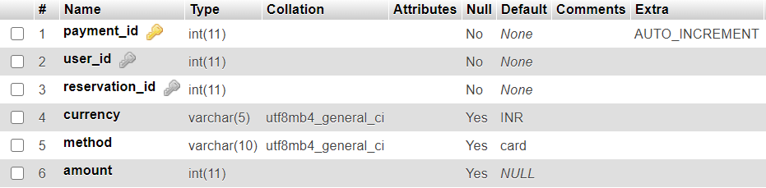
LDR Sensor
Reservation Table
Payments Table
9
Solar tracking system using Arduino
Notes:
9

Slide 10
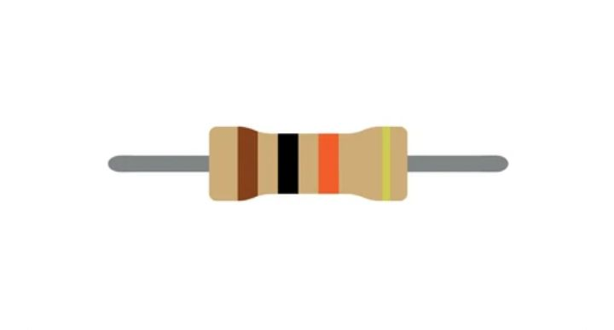




10k resistor
Software Requirements:
Development Tools:
Front End : HTML, CSS, JAVASCRIPT, JQUERY, BOOTSTRAP
Back End : PHP, MySQL
Operating System : Windows 10
Web server : XAMPP
Package Manager: Composer, NPM
Text Editor: VS Code
10
Solar tracking system using Arduino
Notes:
10

Slide 11
Arduino Code
#include<servo . h>
servo servo;
int east LDR=0;
int west LDR=1;
Int east = 0;
int west =0;
int error =0;
int calibration = 0;
int servo position = 90;
void setup()
{
Servo . attach(9);
11
Solar tracking system using Arduino
Notes:
11

Slide 12
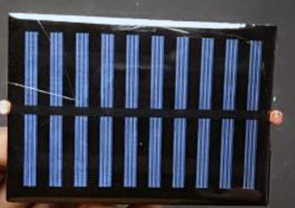

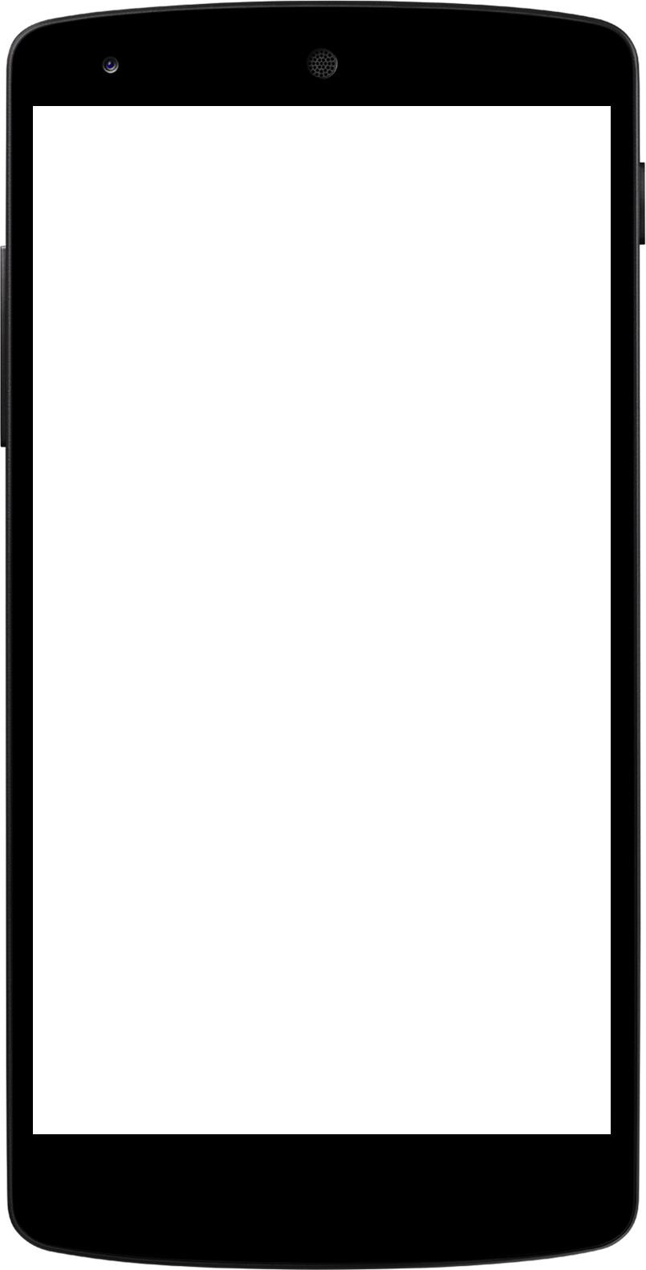
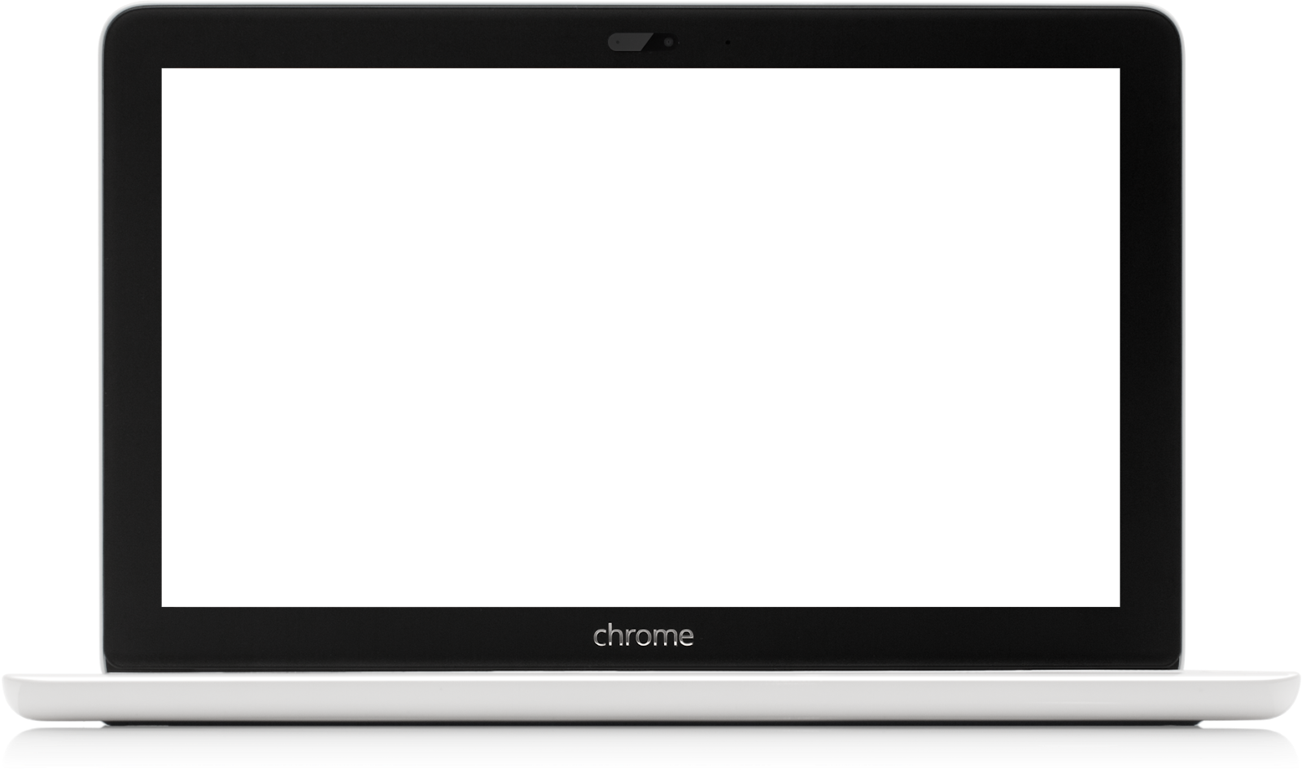
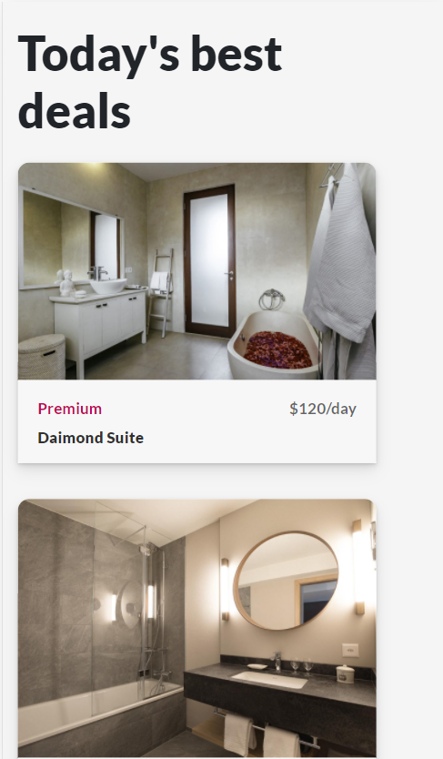

}
east= calibration+analogRead(eastLDR)
west=analogRead(west LDR)
if(east<350 && west<350)
{
while(servoposition<=150)
{
servo position++;
servo.write(servoposition);
delay(100);
}
error = east-west;
if(error>30)
{
if(servoposition<=150)
12
Solar tracking system using Arduino
Notes:
12

Slide 13
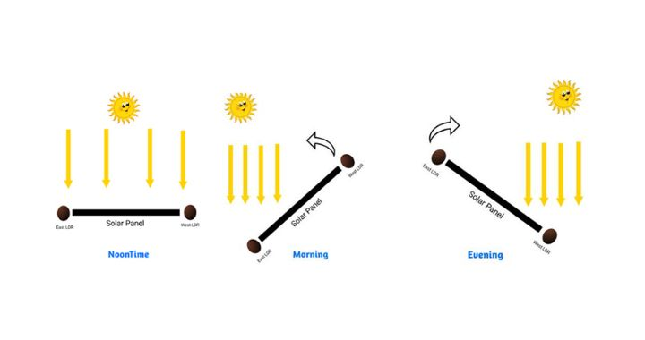
{
servoposition++;
servo.write(servoposition);
}
}
else if (error<-30)
{
if (servoposition>20)
{
servoposition--;
servo.write(servoposition);
}
13
Solar tracking system using Arduino

Slide 14
Conclusion
Compared to their traditional fixed-position counterparts, solar systems which track the change in the sun’s trajectory over the course of the day collect a far greater amount of solar energy, and therefore generate a significantly higher output power.
14
Solar tracking system using Arduino
Notes:
14

Slide 15
Future Scope
This technology is particularly promising in region with high solar irradiance, providing an efficient means to harness abundant sunlight.
Additionally, advancements in solar tracking technology, such as smart tracking algorithms and sensor integration, further contribute to increased energy yield.
15
Solar tracking system using Arduino
Notes:
15

Slide 16
References
Web Reference
16
Solar tracking system using Arduino
Notes:
16

Slide 17

Thank You!
17

